Slide 1
Bitcoin,Blockchain的前世今生與IoT的未來
何建明 研究員
hoho@iis.sinica.edu.tw
http://www.iis.sinica.edu.tw/~hoho/

Slide 2
Agenda
Bitcoin介紹
IoT的前世今生
Blockchain的前世今生
Why IoT needs Blockchain?
Blockchain與IoT的未來
Concluding Remarks

Slide 3
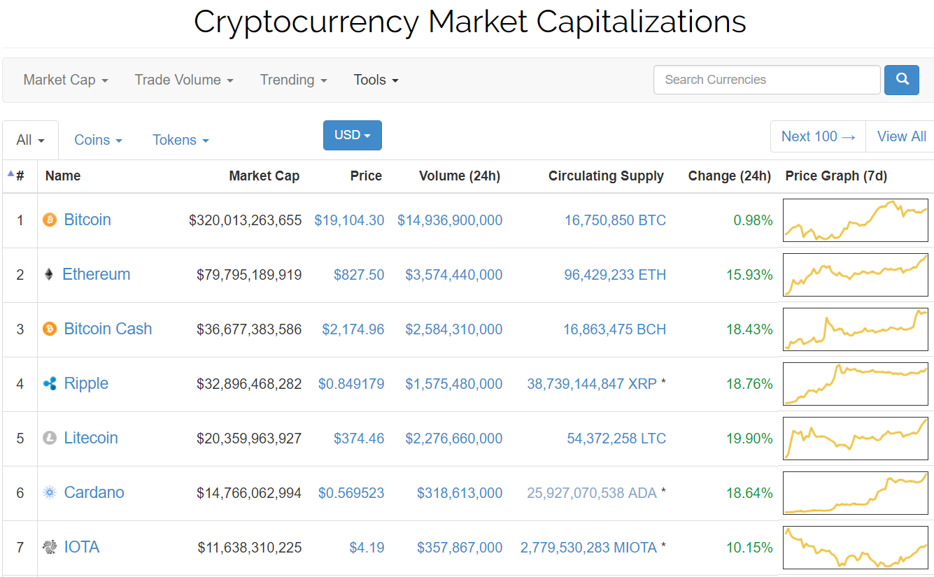
加密貨幣市場
Market Cap: $631,339,916,895 / 24h Vol: $40,690,150,614 /
BTC Dominance: 50.7%

Slide 4
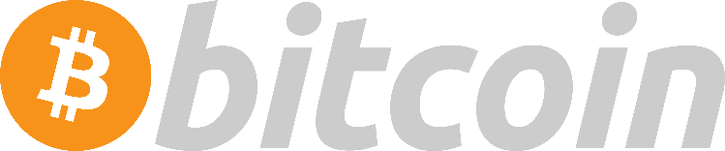
Bitcoin 比特幣
特色：
開始於：2009年11月 最早
預計發行總量：2100萬個比特幣 – 所以具備稀缺性
貨幣發行演算法為：工作量證明算法(Proof Of Work, POW)
資料的型態為Unspent Transaction Output(UTXO)
缺點：
系統能夠處裡的每秒交易量為 7 TPS (Transactions Per Second)
區塊鏈資料越來越龐大 高達150GB
因為採用POW導致 大量的電力耗損
Notes:
比特幣的Proof of Work, 解決基本的Double Spending, 以及P2P網路都是引用別人, 但Blockchain, UTXO以及Smart Contract是中本聰的原創

Slide 5
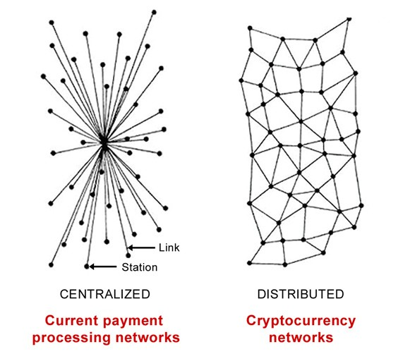
Bitcoin System Overview
A decentralized system (p2p network)
Creation of Bitcoins (mining from POW)
Recording of all bitcoin transfers (Blockchain)
System Infrastructure
Generating addresses for receiving and storing bitcoins
Method of ensuring the rightful owner of bitcoins stored in an address can move them to a new address (i.e. UTXO)
A distributed and duplicated database (i.e. blockchain)storing the past transactions to prevent the double spending of the bitcoins stored in an address

Slide 6
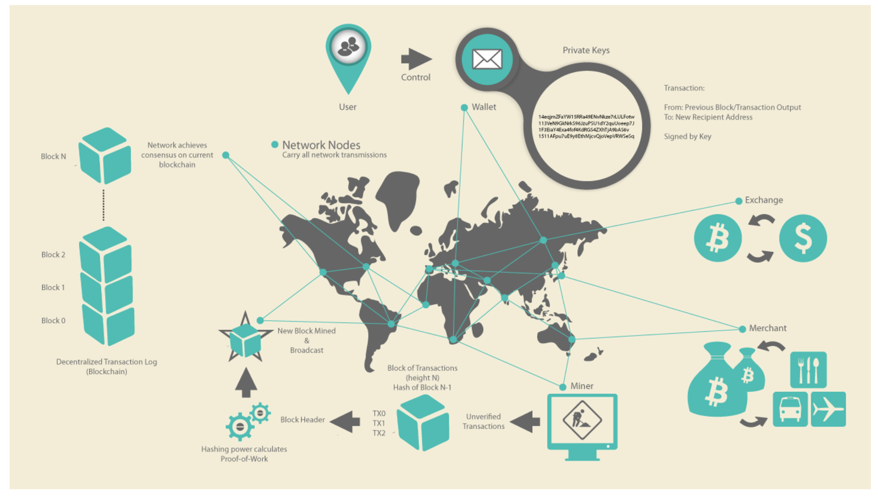
比特幣peer to peer網路運作

Slide 7
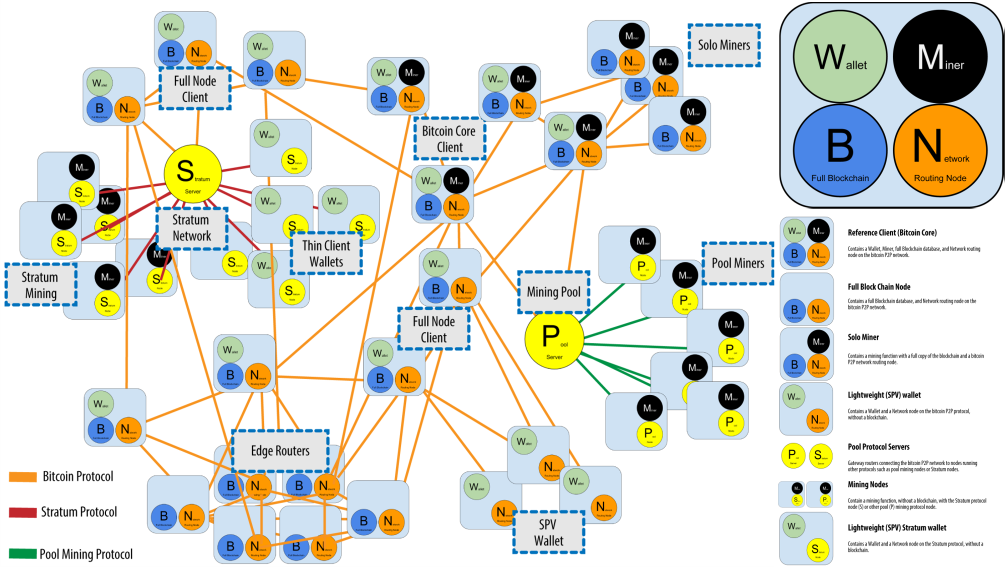
比特幣網路節點型態

Slide 8
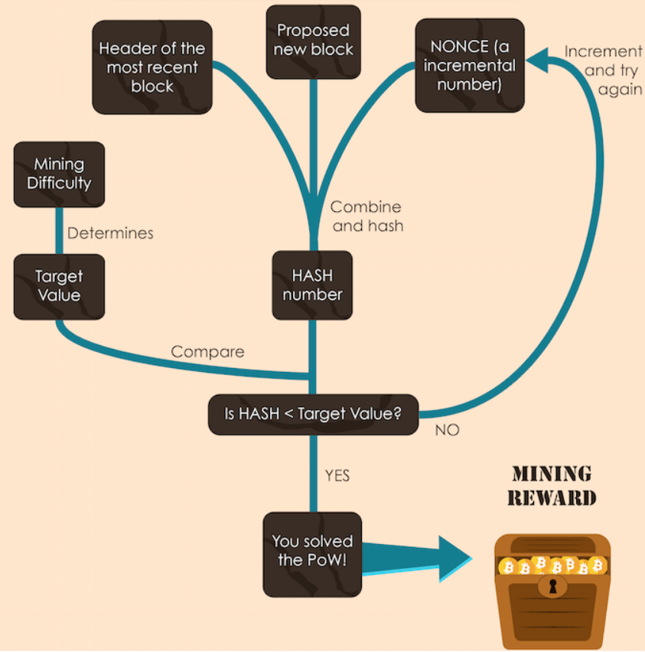
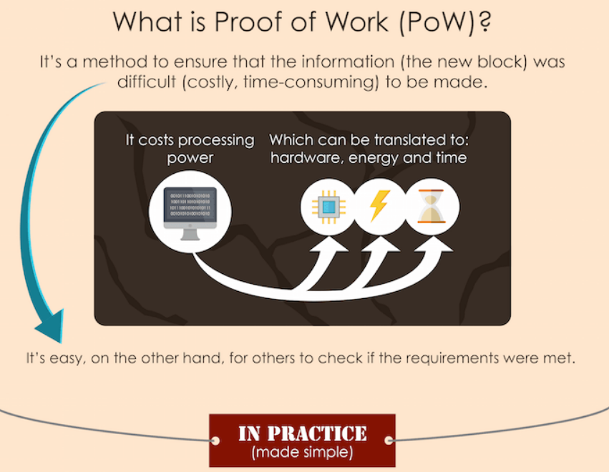
POW

Slide 9
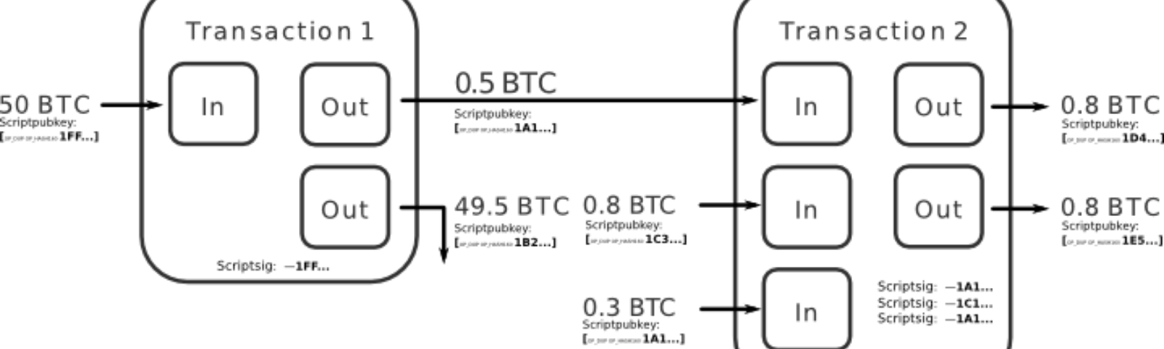
UTXO Unspent Transaction Output
Notes:
比特幣花用的資料結構, 需要有Alice花錢人的簽章及公鑰, 收錢人的公鑰就可以開始交易, 進入錢包UTXO pool, 如果沒有問題(餘額), 會進入Memory Pool, 再沒有問題(雙花, 手續費)就進區塊鏈

Slide 10
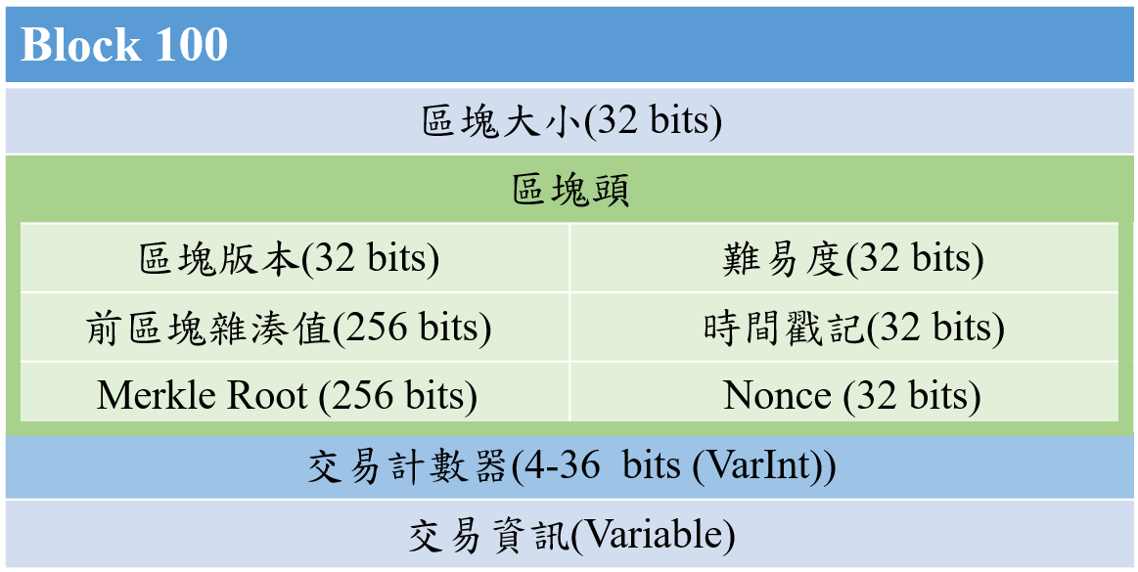
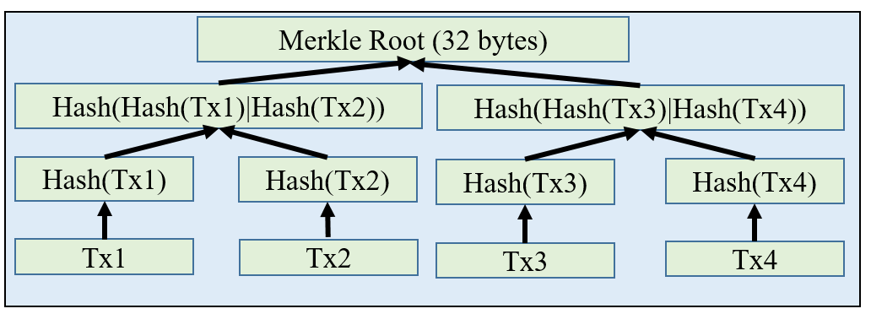
交易區塊及區塊鏈
Notes:
難易度及Nonce與Miner的POW有關

Slide 11
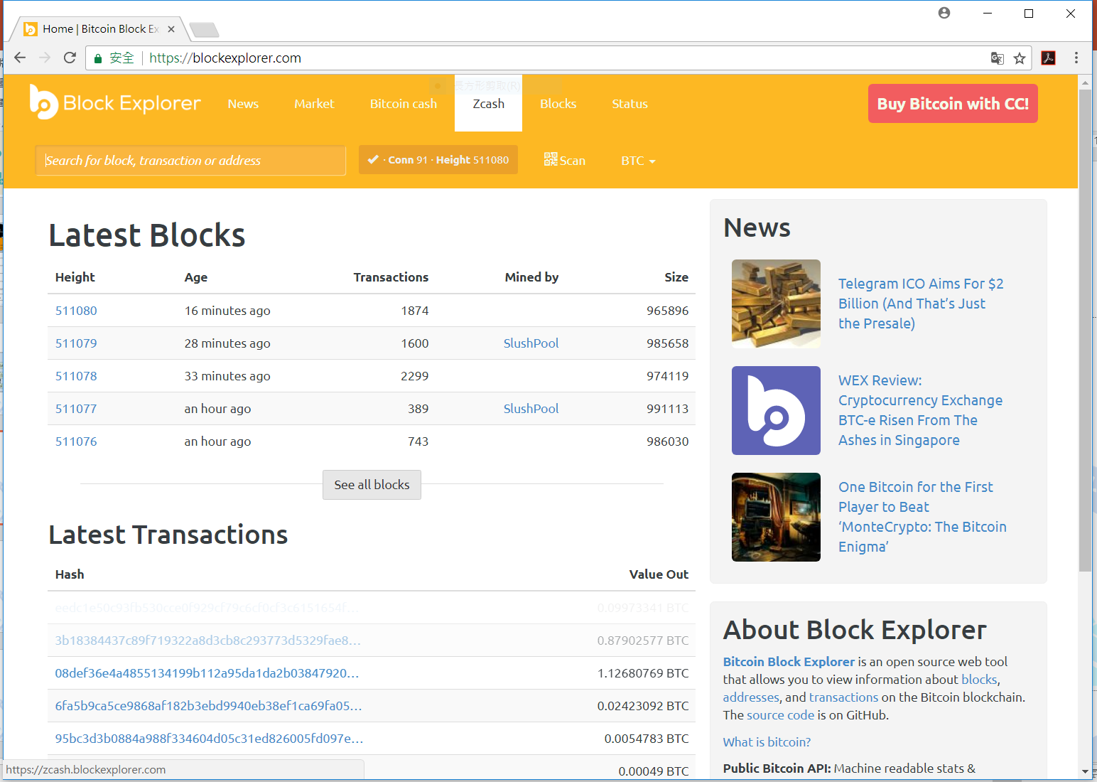
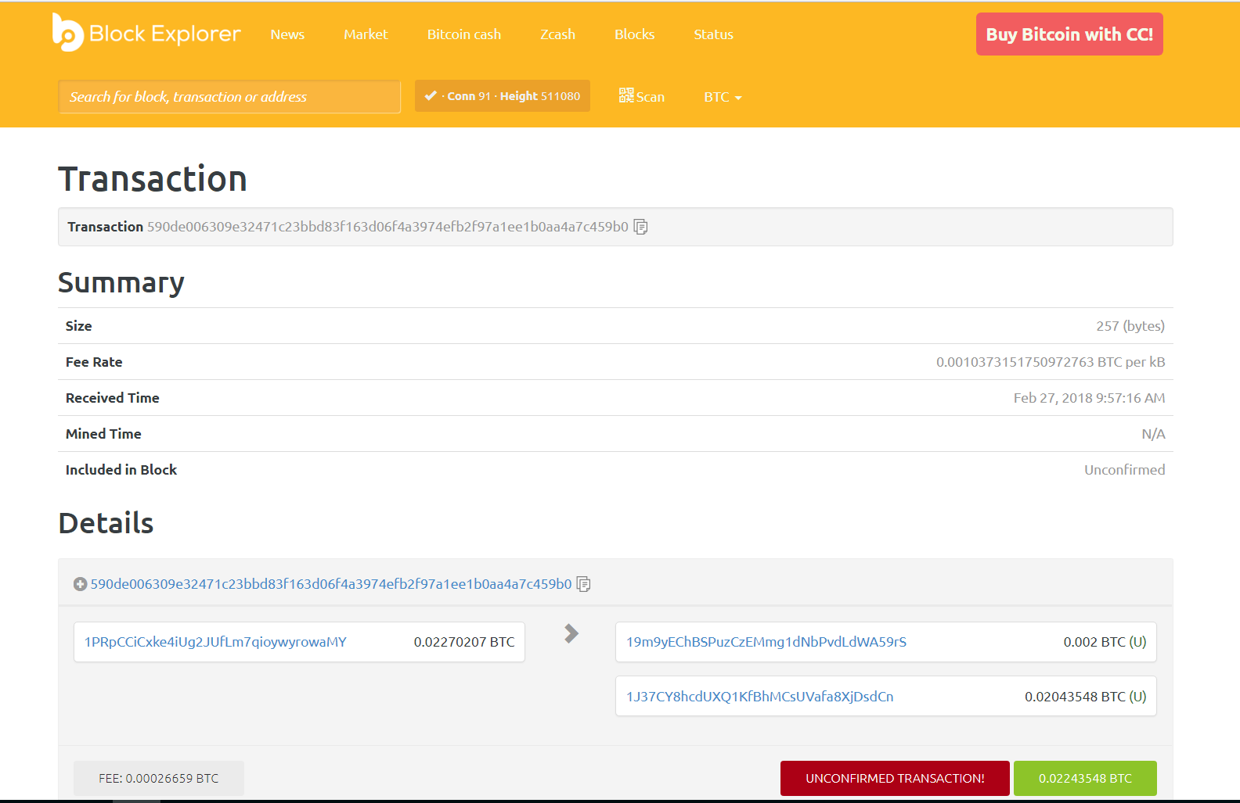
利用Blockchain Explorer檢視交易

Slide 12
Bitcoin Address

Slide 13
雜湊函數
雜湊函數 = 散列函數 = 哈希函數 = Hash Function
包括：
訊息摘要(Message Digest，MD)
安全雜湊演算法(Secure Hash Algorithm，SHA)
RIPEMD-160
特色
擴散性(Diffusion) 只要有一個bit的變化就會完全不同
不可逆性(Irreversible) 如 1TB的檔案做SHA-256 很難反推
抗碰撞性(Collision resistance) 很難遇到不同的輸入 有同樣的輸出

Slide 14
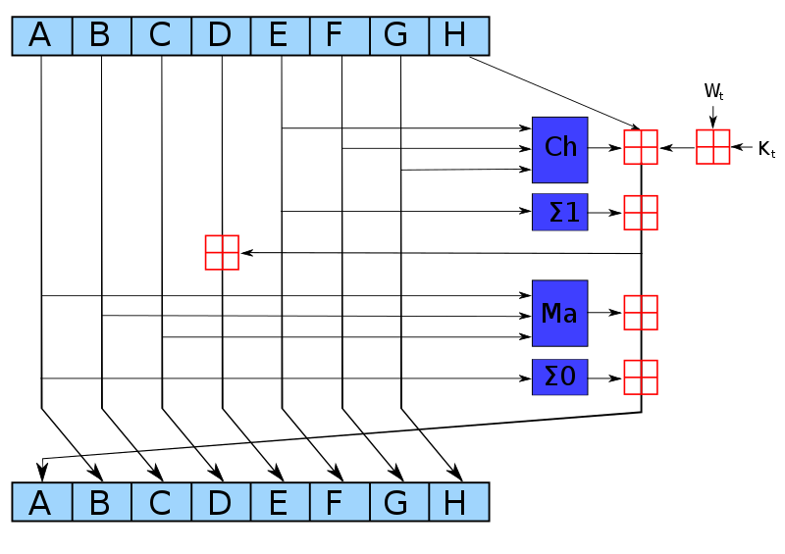
SHA
t2
h0 := 0x6a09e667 h1 := 0xbb67ae85 h2 := 0x3c6ef372 h3 := 0xa54ff53a h4 := 0x510e527f h5 := 0x9b05688c h6 := 0x1f83d9ab h7 := 0x5be0cd19
h0：= h0 + a h1：= h1 + b h2：= h2 + c h3：= h3 + d h4：= h4 + e h5：= h5 + f h6：= h6 + g h7：= h7 + h
h：= g
g：= f
f：= e
e：= d + t1
d：= c
c：= b
b：= a
a：= t1 + t2
Initialize variables
t1
s0 := (a rightrotate 2) xor (a rightrotate 13) xor(a rightrotate 22)
s1 := (e rightrotate 6) xor (e rightrotate 11) xor(e rightrotate 25)
maj:= (a and b) xor (a and c) xor(b and c)
ch := (e and f) xor ((not e) and g)
t1 := h + s1 + ch + k[i] + w[i]
t2 := s0 + maj

Slide 15
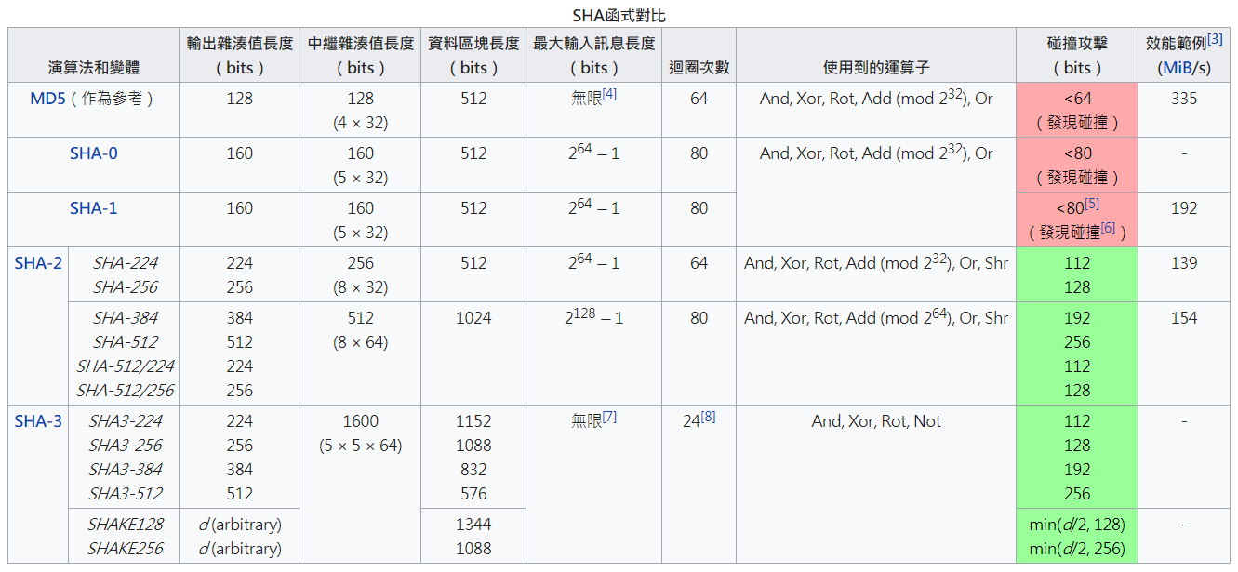

Slide 16
Value | Character | Value | Character | Value | Character | Value | Character
0 | 1 | 1 | 2 | 2 | 3 | 3 | 4
4 | 5 | 5 | 6 | 6 | 7 | 7 | 8
8 | 9 | 9 | A | 10 | B | 11 | C
12 | D | 13 | E | 14 | F | 15 | G
16 | H | 17 | J | 18 | K | 19 | L
20 | M | 21 | N | 22 | P | 23 | Q
24 | R | 25 | S | 26 | T | 27 | U
28 | V | 29 | W | 30 | X | 31 | Y
32 | Z | 33 | a | 34 | b | 35 | c
36 | d | 37 | e | 38 | f | 39 | g
40 | h | 41 | i | 42 | j | 43 | k
44 | m | 45 | n | 46 | o | 47 | p
48 | q | 49 | r | 50 | s | 51 | t
52 | u | 53 | v | 54 | w | 55 | x
56 | y | 57 | z
Base58
Base58字母表，Base58就是由不包括（0，O，l，I）的大小寫字母和數字組成。
123456789ABCDEFGHJKLMNPQRSTUVWXYZabcdefghijkmnopqrstuvwxyz

Slide 17
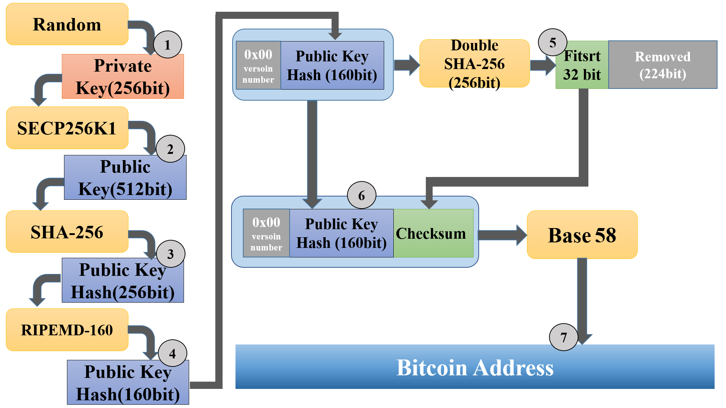
Bitcoin Address 生成 過程
1KwA4fS4uVuCNjCtMivE7m5ATbv93UZg8V

Slide 18
Summary^{[16]}
User interact with the blockchain via a pair of private/public keys.
Private key to sign the transaction
Transaction is addressable by public key
The neighboring peers ensure this incoming transaction is valid before relaying it further
Discard TX if invalid
Otherwise, Eventually TX is spread across the entire network
Then, transactions been collected and validated during an agreed-upon time interval are ordered and packaged into candidate block,
Mining node broadcasts this block back to the network to ask for consensus confirmation
Consensus nodes verify the candidate block
If OK, add the block to blockchain, apply the transactions of the confirmed block.
It Not OK, discard the block

Slide 19
Double Spending

Slide 20

Double spending attack
大致分為兩類 Memory Pool 、 進blockchain之後
Memory Pool
成因：場景為 “攻擊者”要給 “A” 100元，但 之後 “攻擊者”又給 “B” 100元，但給後者的手續費較高
後果：造成零確認運營商損失
https://shapeshift.io/#/coins
https://blog.blockcypher.com/yes-someone-double-spent-bitcoin-no-zero-confirmation-payments-are-not-dead-944d021b865e

Slide 21
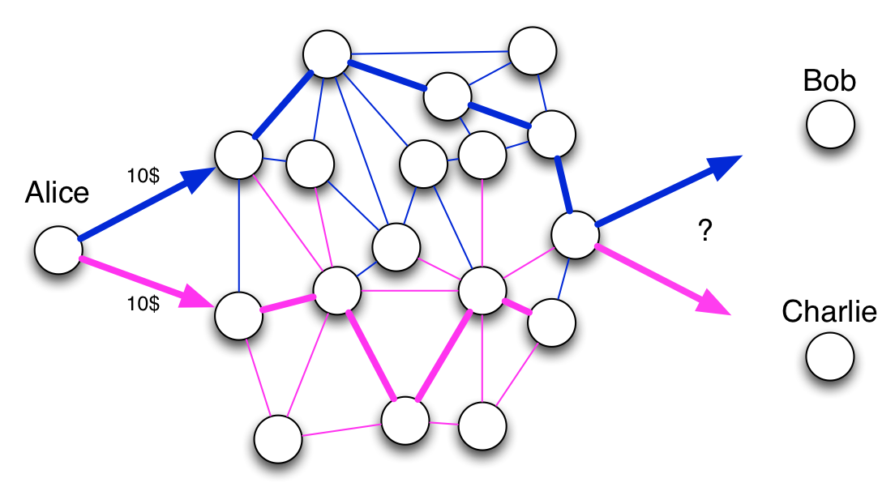
Double Spending – Tx Memory Pool

Slide 22
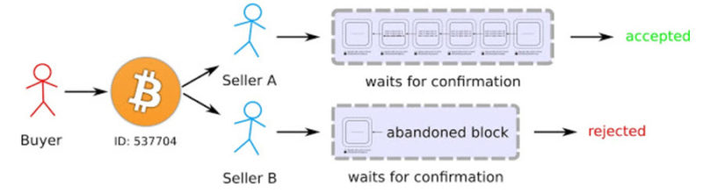

Slide 23
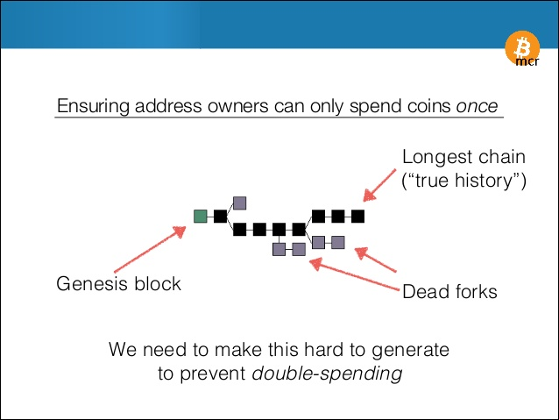
Double Spending – blockchain fork

Slide 24
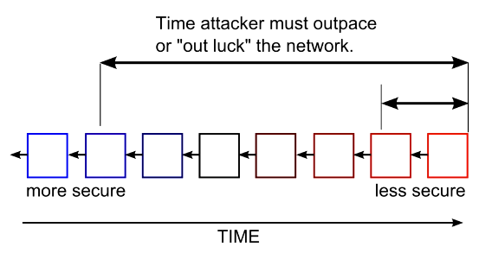

Slide 25

IoT的前世今生(IoT 1.0及IoT 2.0)
IoT 1.0
SNMP
Simple Network Management Protocol
LAN/UDP
CWMP
CPE WAN Management Protocol
WAN/HTTP
IoT 2.0
REST API
REpresentational State Transfer
WAN/HTTP
Notes:
IoT 2.0也還是Client-Server Model

Slide 26
Blockchain的前世今生與未來 http://w2.blockchain-tec.net/blockchain/blockchain-by-melanie-swan.pdf
BC 1.0
Only for Cryptocurrency
Most famous Bitcoin
Help cryptocurrency complete the funding transfer between Internet users
BC 2.0
Practiced to Smart Contract
Financial products
stocks, bonds, futures, loans, property rights, smart assets and smart contracts
viewed as a database and inventory list for recording, tracking and transferring of all assets.
a record of any formation of asset registration, inventory and transaction information.
BC 3.0
Disengage from the applications of the market economy and finance
It emphasizes more on government, health, science, literature, culture, art and other fields
Health-care blockchain, food-safety blockchain, hotel-booking blockchain and certificate blockchain
e.g., in the Estonian government since 2016, the national identity card is built in the blockchain, to sign a commercial contract or an application for marriage certificate.

Slide 27
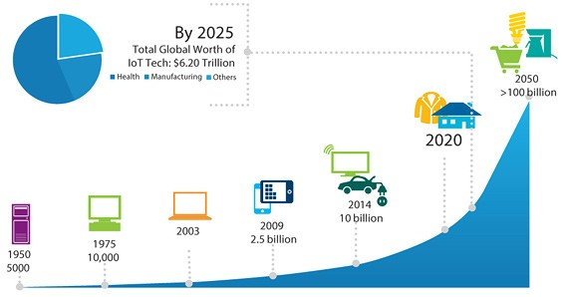
Why IoT needs Blockchain?
Internet of Things (IoT) is often mentioned alongside the likes of AI as a technology set to change the world in the near future
Gartner said there will be more than 20 billion connected devices by 2020
2050, $6.2 Trillion on IoT Tech
Challenges
Scalability
Lack of standardization
Protocolization
Security
Transparent
Availability
Immune censorship

Slide 28
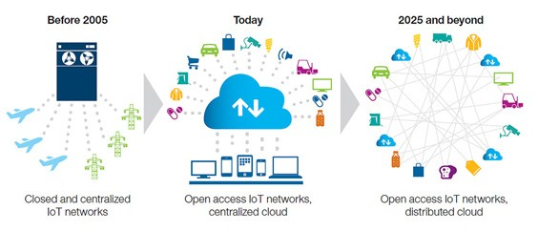
IoT的前世今生與Blockchain的未來 https://www.rs-online.com/designspark/when-the-blockchain-technology-meets-the-internet-of-things

Slide 29
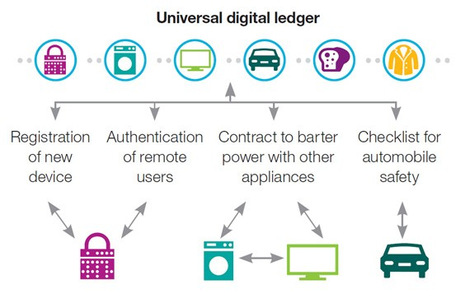
IoT與Blockchain的未來 就在全球化的數位帳本

Slide 30
Blockchain與IoT的未來
Blockchain & Smart Contrats for IoT

Slide 31
Smart Contract https://blog.gasolin.idv.tw/2017/09/02/what-is-smart-contract/
在Blockchain上運行的程式
通常指的是以可以在Ethereum區塊鏈上執行的Turing Completeness程式
如果相容於ERC20標準，不需重新開發從挖礦到交易的整個代幣生態系統
新加密代幣可以直接使用支援以太坊的電子錢包💰來收送
投資者或贊助者還可以隨時交易這些代幣
讓資金的運用變得更加彈性，也降低了投資的門檻
Smart Contracts也讓募資💸變得更透明。參與者投資資金或提供服務，也可獲得相應的權益
這份權益可以用代幣的形式返還給參與者
可以用來運作各式公開公正的自動服務機構(DAO，Decentralized Autonomous Organization)🏦
透過分散在全球各節點上運作的智能合約
所有運作與決策都是公開透明的
降低了交易的不確定性(Uncertainty)。

Slide 32
Smart Contract https://blog.gasolin.idv.tw/2017/09/02/what-is-smart-contract/
Continued
Smart Contract和一般程式的差異
整合金流容易
部署時與後續寫入時需費用
分給參與交易驗證(挖礦)的人
Contract會作為不可更改的區塊鏈的一部分
分散地儲存在全球各地Ethereum的節點上
查詢已寫入Blockchain的靜態資料時不需費用
在每次透過Smart Contract寫入或讀取計算結果時，需要提供一小筆交易費用
儲存資料的成本更高
Smart Contract將資料儲存在Blockchain上，儲存資料所需的時間與成本相對昂貴
部署後無法更改
開發者透過加入額外的Smart Contract，可躲過原Smart Contract部署後無法再更改的限制

Slide 33
Smart Contract https://blog.gasolin.idv.tw/2017/09/02/what-is-smart-contract/
Continued
如何撰寫Smart Contract？
Ethereum上的智能合約需要使用solidity語言來撰寫
solidity是一種類似Javascript的語言
圍繞著solidity的各種開發工具鏈都是使用屬於Javascript生態系的npm來提供
其他有Serpent(類Python)、lll(類Fortran)

Slide 34
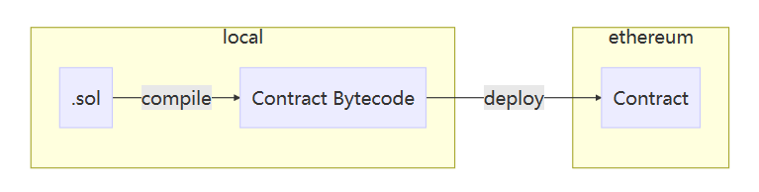
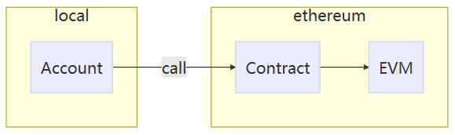
Smart Contract https://blog.gasolin.idv.tw/2017/09/02/what-is-smart-contract/
Continued
將Smart Contract部署到Blockchain的流程
先將solidity程式碼程式碼(.sol)compile成EVM(Ethereum Virtual Machine)能讀懂的二進位Contract ByteCode
部署ByteCode到Ethereum Blockchain上執行
部署到區塊鏈上的合約會有一個和錢包地址(Wallet Address)一樣格式的合約地址(Contract Address)
部署後的Smart Contract可自動執行
後續呼叫智能合約的時候
可以使用部署合約的錢包地址(Owner Account)
或依據撰寫的智能合約條件，讓其他錢包地址也能呼叫這個智能合約
所謂的"呼叫智能合約"，其實就是向這個合約地址發起交易，只是交易的不只是代幣，而可以是智能合約提供的呼叫方法

Slide 35
Blockchain & Smart Contract for IoT
Blockchain provides an elegant solution to issues above by a scalable, trustless p2p model
Operating transparently
Distributed data securely
But how?
5 case studies

Slide 36
Case Study 1 of BC-IoT
IoT device firmware update
All the IoT devices of a manufacturer operate on same BC network
Deploy a smart contract
allows devices to store the hash of latest firmware stored on p2p file system
Devices can query the contract
Find out about the new update
Request the update via the hash from the p2p file system such as IPFS
The first request of the update is served by the manufacturer server
Then, the update binary has propagated to enough nodes
Manufacturer server can stop service

Slide 37
Case Study 2 of BC-IoT
Filecoin service allows devices to rent their diskspace
Myrid, 21.co and EtherAPIs make possible to monetize API calls
Caller needs to provide the necessary micropayment (Bitcoin/Ethereum)
With a cryptocurrency in place, every device can have its own bank account on the Internet
Device can expose its resources to other devices (or users)
Get compensated for others usage via microtransactions

Slide 38
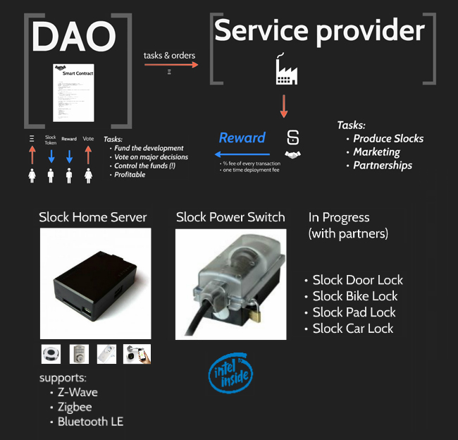
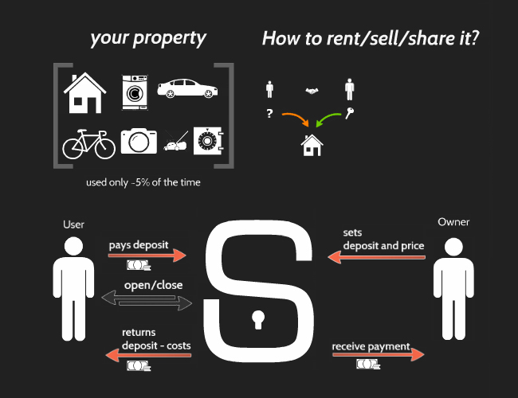
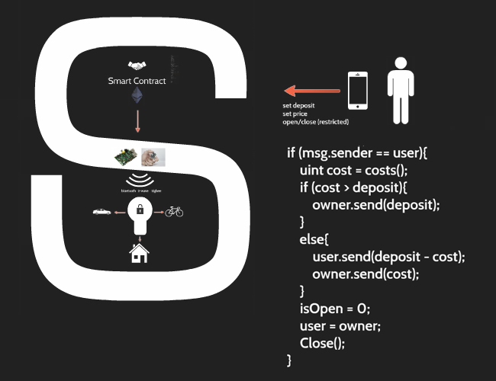
Case Study 3 of BC-IoT
Slockit also facilitates the sharing of services & property
Smart electronic lock

Slide 39
Case 4 of BC-IoT
TransActive Grid
Experiment with concept of p2p market for renewable energy in Brooklyn, NY
Solar panels record their excess output on the blockchain
Sell it to neighboring parties via smart contract

Slide 40
Case 5 of BC-IoT
Supply Chain using blockchain
Asset tracking example using smart contracts and IoT
At B-C stage, container carrier handshakes with the dock at destination C
To confirm container is delivered to expected location
Once the handshake is completed, it posts to a smart contract
OK, The destination port C confirm the reception
Not OK, the shipping will know and can initiate an investigation on C

Slide 41
BC-IoT Deployment Consideration
Lower transaction processing throughput
Ethereum works for shardability in concurrency, but not good enough for IoT
Maintaining privacy in open blockchain?
A couple ways to mitigate the issue
To make pattern identification difficult
Have your device use a new key for every transaction
Use a different key per transacting counter-party
In case of private blockchains
Not use the blockchain for all transactions
Minimize exposure of device by setting up blockchain only with entities must collaborate
Provides a look into methods of blockchain analysis and into ways to prevent them

Slide 42
BC-IoT Deployment Consideration
Continued
Miner can prevent a new valid transaction from being added to BC
If the number of miner conspire violates the threshold?
The nodes of mining set need to be selected wisely
In a private network, legal contracts should be signed so that collusions are penalized appropriately
Legal enforceability of smart contracts is limited
Complete autonomy is double-edged sword
There may be a function that allows a privileged user (identifiable by their key)
destroy and remove the deployed contract from blockchain and VM

Slide 43
BC-IoT Deployment Consideration
Continued
BC-IoT network may also need some mechanism to compensate the functionality
A DNS service that holds pointer to resources
Secure communication and file exchange

Slide 44
Concluding Remarks
Blockchain/smart-contract provides a convenient billing layer and paves the way for a marketplace of services between devices
How to guarantee the IoT tx input with correctness/value?
Garbage In Garbage Out?
How to lower the ever-expanding IoT tx rate?
Bitcoin→7 TPS, Ethereum→20TPS
How to design a scalable and compatible blockchain structure
To comply with diversified devices
How to connect legacy IoT devices to BC-IoT devices?
Devices with IoT 1.0, 2.0

Slide 45
Thanks for listening~

Slide 46
Reference
[1] Satoshi Nakamoto. Bitcoin: A peer-to-peer electronic cash system, 2008.
[2] Ethereum Foundation Vitalik Buterin. Ethereum, 2015-07. https://ethereum.org.
[3] solidity. https://solidity.readthedocs.io/en/develop/.
[4] Cryptocurrency Market Capitalizations. https://coinmarketcap.com/all/views/all/.
[5] John Gregor Fraser and Ahmed Bouridane. Have the security flaws surrounding BITCOIN effected the currency’s value?, 2017: 50–55.
[6] Kyle Torpey. “You Really Should Run a Bitcoin Full Node: Here’s Why”. Bitcoin Magazine, 2017.
[7] Bitcoin Improvement Proposals. https://github.com/bitcoin/bips/blob/master/README.mediawiki.
[8] blockchain.info. Blockchain Size, 2018. https : / / blockchain . info / charts / blocks - size ? timespan=all.
[9] J Göbel and AE Krzesinski. “Increased block size and Bitcoin blockchain dynamics”. In: Telecom- munication Networks and Applications Conference (ITNAC), 2017 27th International, 2017: 1–6.
[10] Taher ElGamal. “A public key cryptosystem and a signature scheme based on discrete logarithms”.
IEEE transactions on information theory, 1985, 31(4): 469–472.
[11] Andrew Miller and Joseph J LaViola Jr. “Anonymous byzantine consensus from moderately-hard puzzles: A model for bitcoin”. Available on line: http://nakamotoinstitute. org/research/anonymous- byzantine-consensus, 2014.

Slide 47
Reference
[12] Don Johnson, Alfred Menezes and Scott Vanstone. “The elliptic curve digital signature algorithm (ECDSA)”. International Journal of Information Security, 2001, 1(1): 36–63.
[13] Dmitry Khovratovich, Christian Rechberger and Alexandra Savelieva; ed. by Anne Canteaut. “Bi- cliques for Preimages: Attacks on Skein-512 and the SHA-2 Family”. In: Fast Software Encryption - 19th International Workshop, FSE 2012, Washington, DC, USA, March 19-21, 2012. Revised Selected Papers. Springer, 2012: 244–263. https://doi.org/10.1007/978-3-642-34047-5_15.
[14] Florian Mendel, Norbert Pramstaller, Christian Rechberger et al.; ed. by Sokratis K. Katsikas, Javier Lopez, Michael Backes et al. “On the Collision Resistance of RIPEMD-160”. In: Information Security, 9th International Conference, ISC 2006, Samos Island, Greece, August 30 - September 2, 2006, Proceedings. Springer, 2006: 101–116. https://doi.org/10.1007/11836810_8.
[15] The Bitcoin Core developers. Base58, 2009. https://github.com/bitcoin/bitcoin/blob/ master/src/base58.cpp.
[16] Christidis, Konstantinos, and Michael Devetsikiotis. "Blockchains and smart contracts for the internet of things." IEEE Access 4 (2016): 2292-2303.
[17] What is proof of work, https://www.bitcoinmining.com/what-is-proof-of-work/

